Slide 1
Showing Estimated Cost
How to validate your cost estimates for your account even without Master Account visibility.
Splunk
May 2020

Slide 2
Agenda
CloudWatch
Create Chart for Spend
Optionally create Alarms for Spend

Slide 3
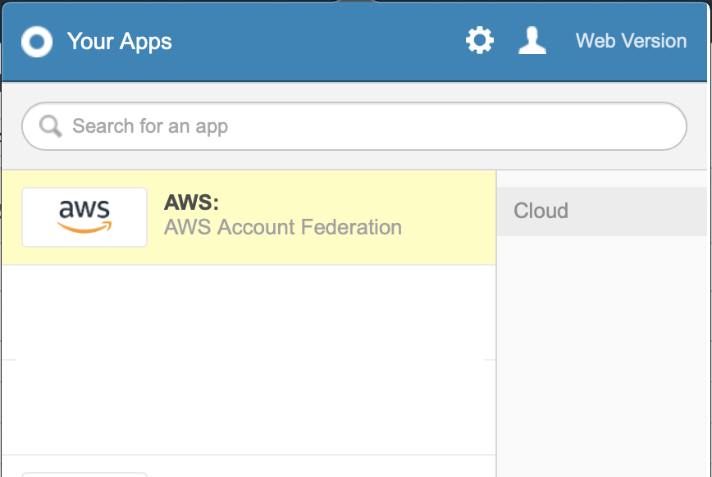
Log into AWS
Use OKTA Chicklet to log into AWS Account

Slide 4
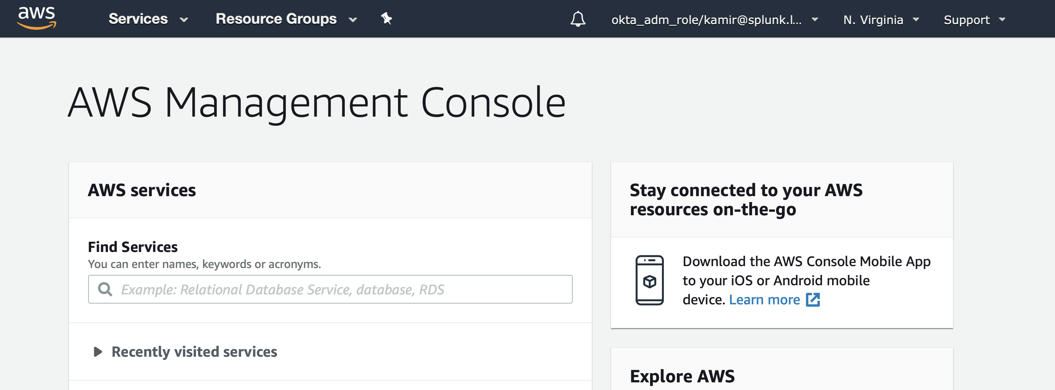
Change your Region to N. Virginia
Make sure you are in N. Virginia (us-east-1)

Slide 5
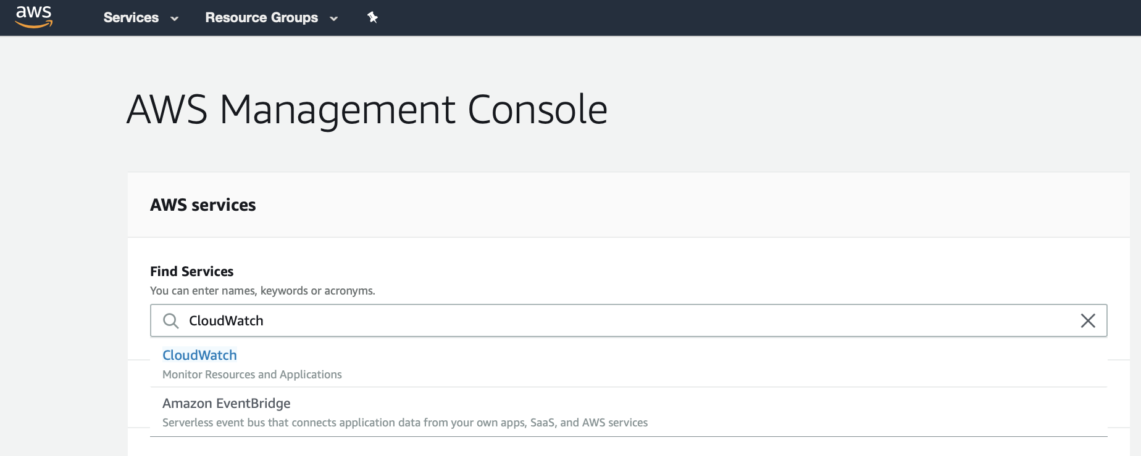
Go to CloudWatch service
Find a service and find “CloudWatch”

Slide 6
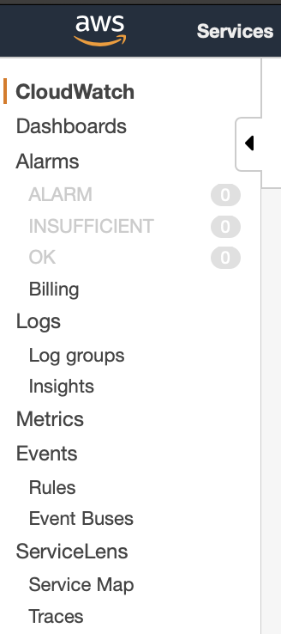
Select Metrics
Use the Metrics

Slide 7
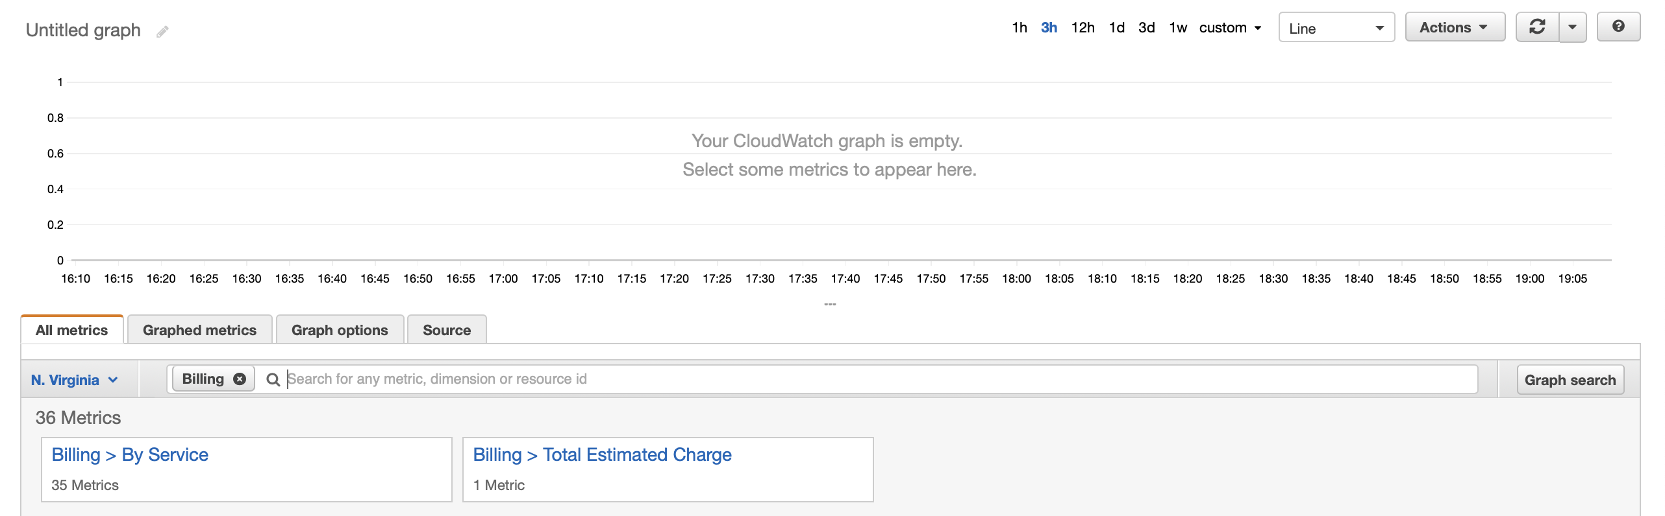
Filter for Billing Metrics
Search for “billing”

Slide 8
Start with Billing > Total Estimated Charge
Change the time to 3d

Slide 9
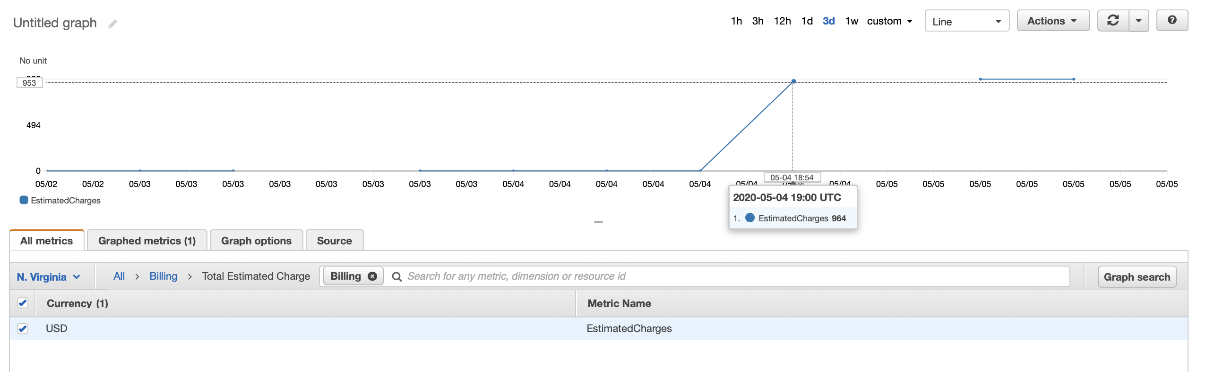
Start with Billing > Total Estimated Charge
Set check box by “USD”

Slide 10
Start with Billing > Total Estimated Charge
Click “Billing” and select another view to the same data

Slide 11
Follow up with Billing > By Service
Click on Billing > By Service

Slide 12
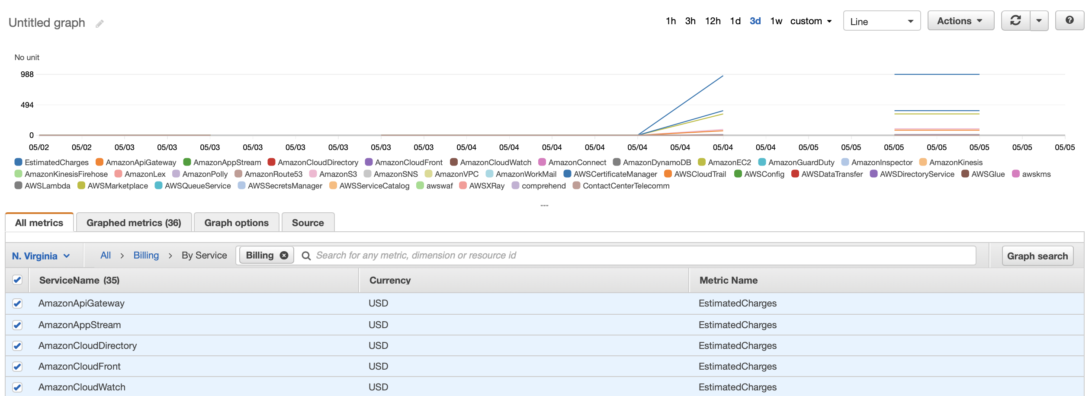
Follow up with Billing > By Service
Click on top level check box for all services

Slide 13
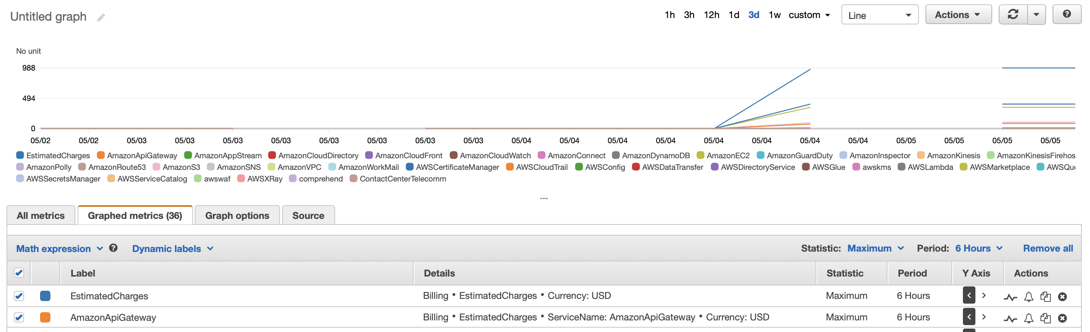
Create Alerts (optionally)
Click on “Graphed metrics”
Click Here

Slide 14
Fin

